Slide 1
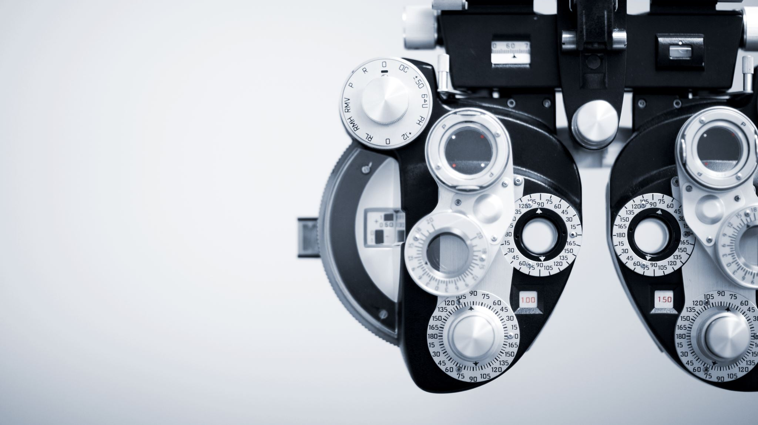

Visual Relationship Detection
Chanwoong john and chaiyeen oh
Notes:
Visual Relationship Detection

Slide 2
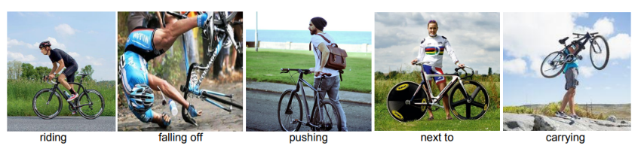
Problem
relationship between objects has more significant interpretation than the objects itself

Slide 3
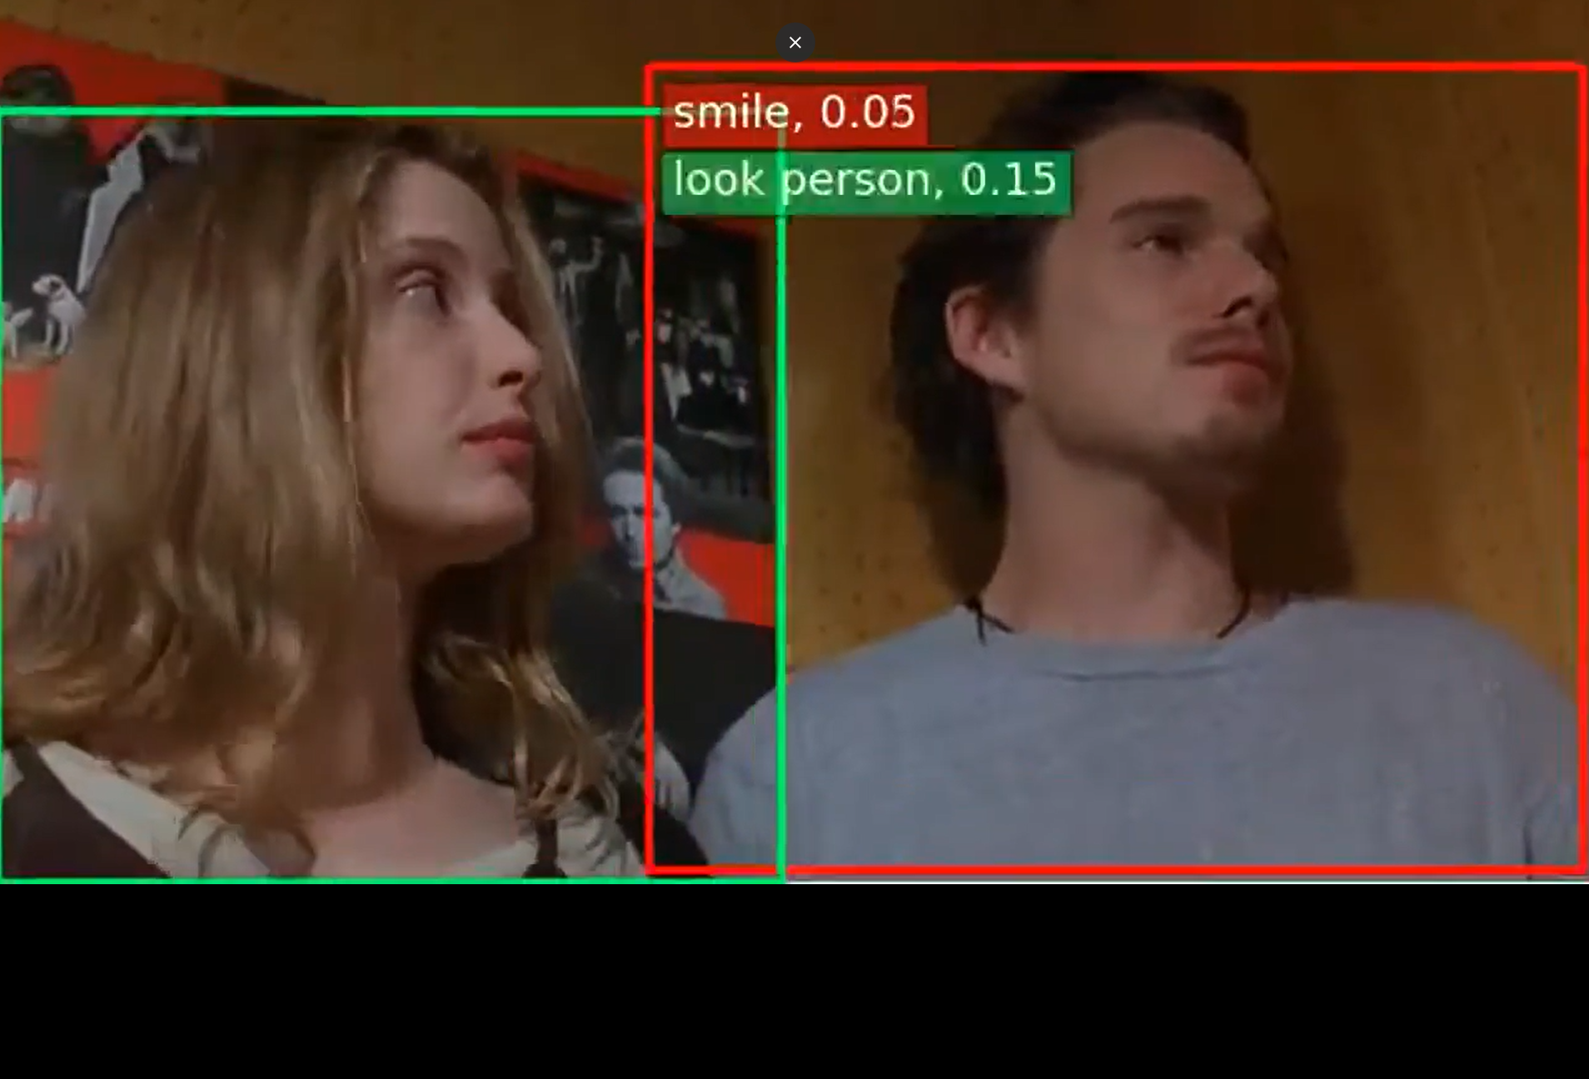
Motivation & Usage
Multi-modal AI
Image Retrieval
local computer, website, GIF search bar
detect accidents in factory
generate description of the images or videos without an audio

Slide 4
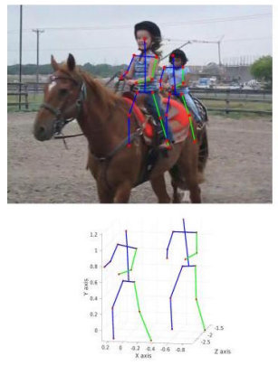
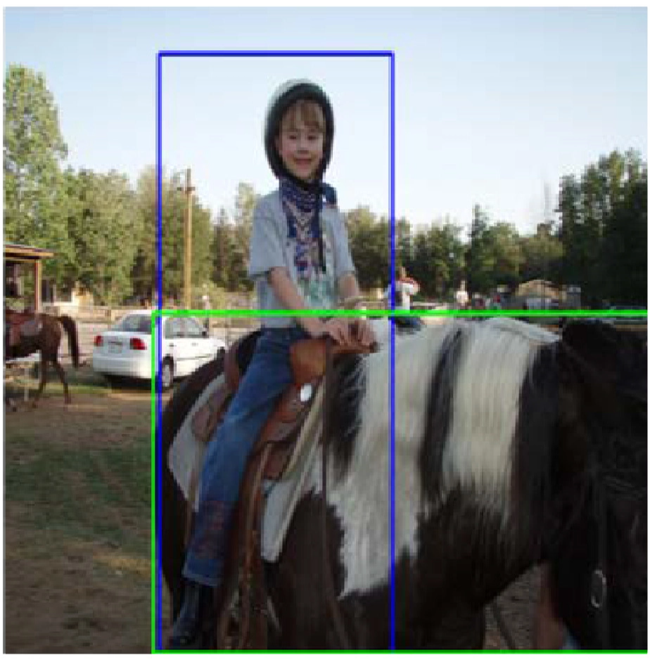
Current State-of-Art
1. Human Pose Estimation 2. Secondary Regions
Person ride horse
Features from human poses
Person ride horse
Union Box

Slide 5
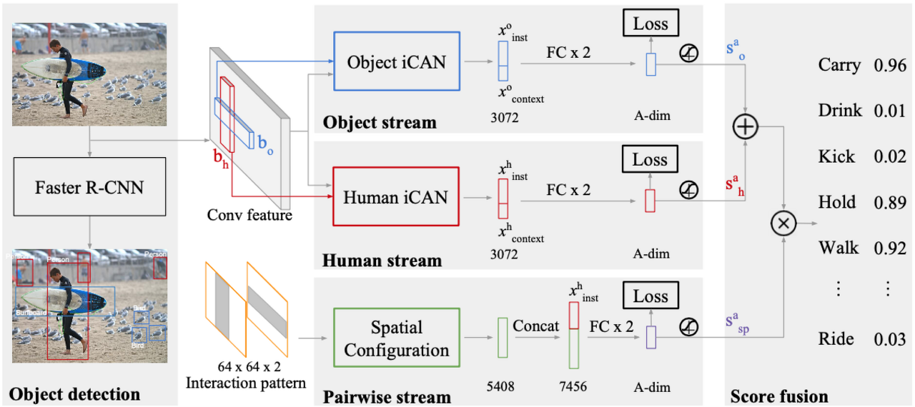
Our Approach
Detect persons and object instances using RCNN
EX. person, surfboard, bird
2. construct three types of prediction models
predicts interaction based on object
detect interaction based on human
detect spatial relationship between a person and object
3. extract most closely related output by computing confidence score which depends on the confidence for the individual object detections

Slide 6
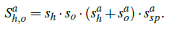
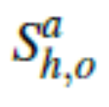
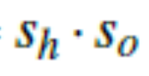

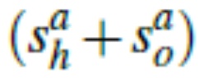
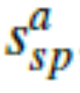
Our Approach - Scoring
score for each action from the number of possible actions
confidence for the individual object detections
interaction prediction based on the appearance of the person
spatial relationship between the person and the object

Slide 7
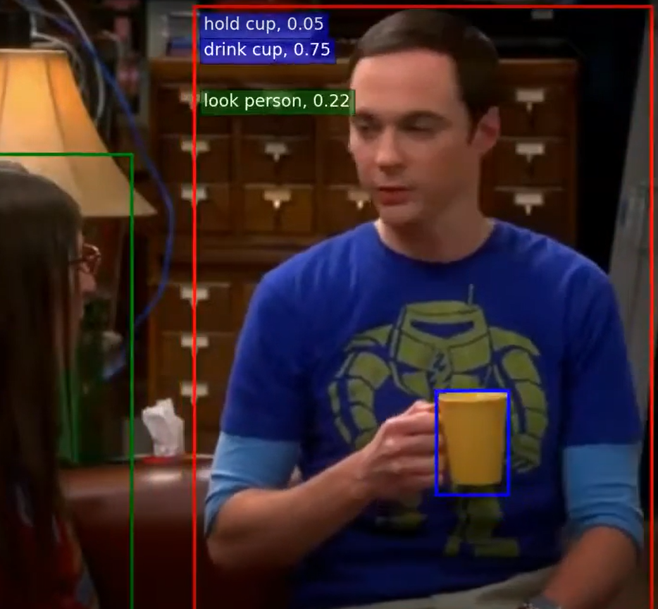
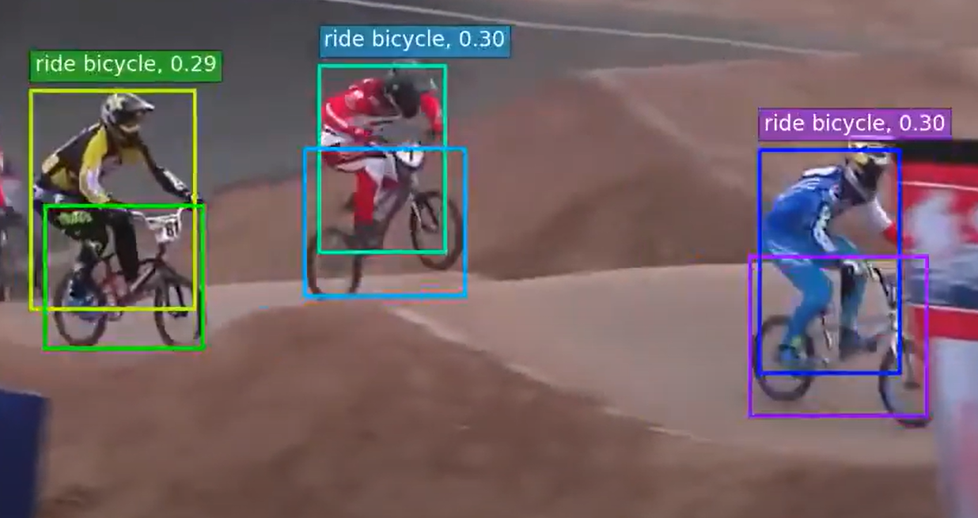
Results
Multiple Interaction 2. Multiple human object

Slide 8

Thank You

